Slide 1

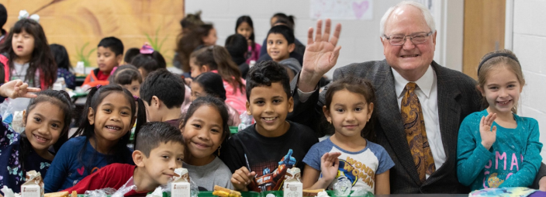
Springdale Public Schools
Springdale, Arkansas
Dr. Jim Rollins, Superintendent

Slide 2

The Vision of Springdale Public Schools is
“Teach them ALL,
ALL means ALL”

Slide 3
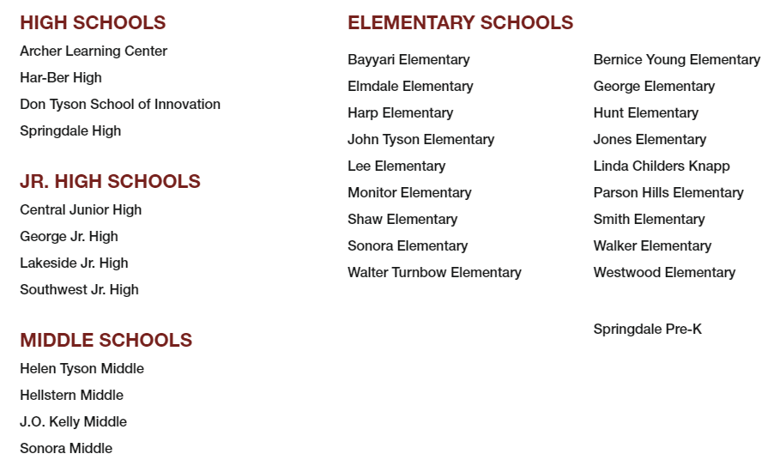
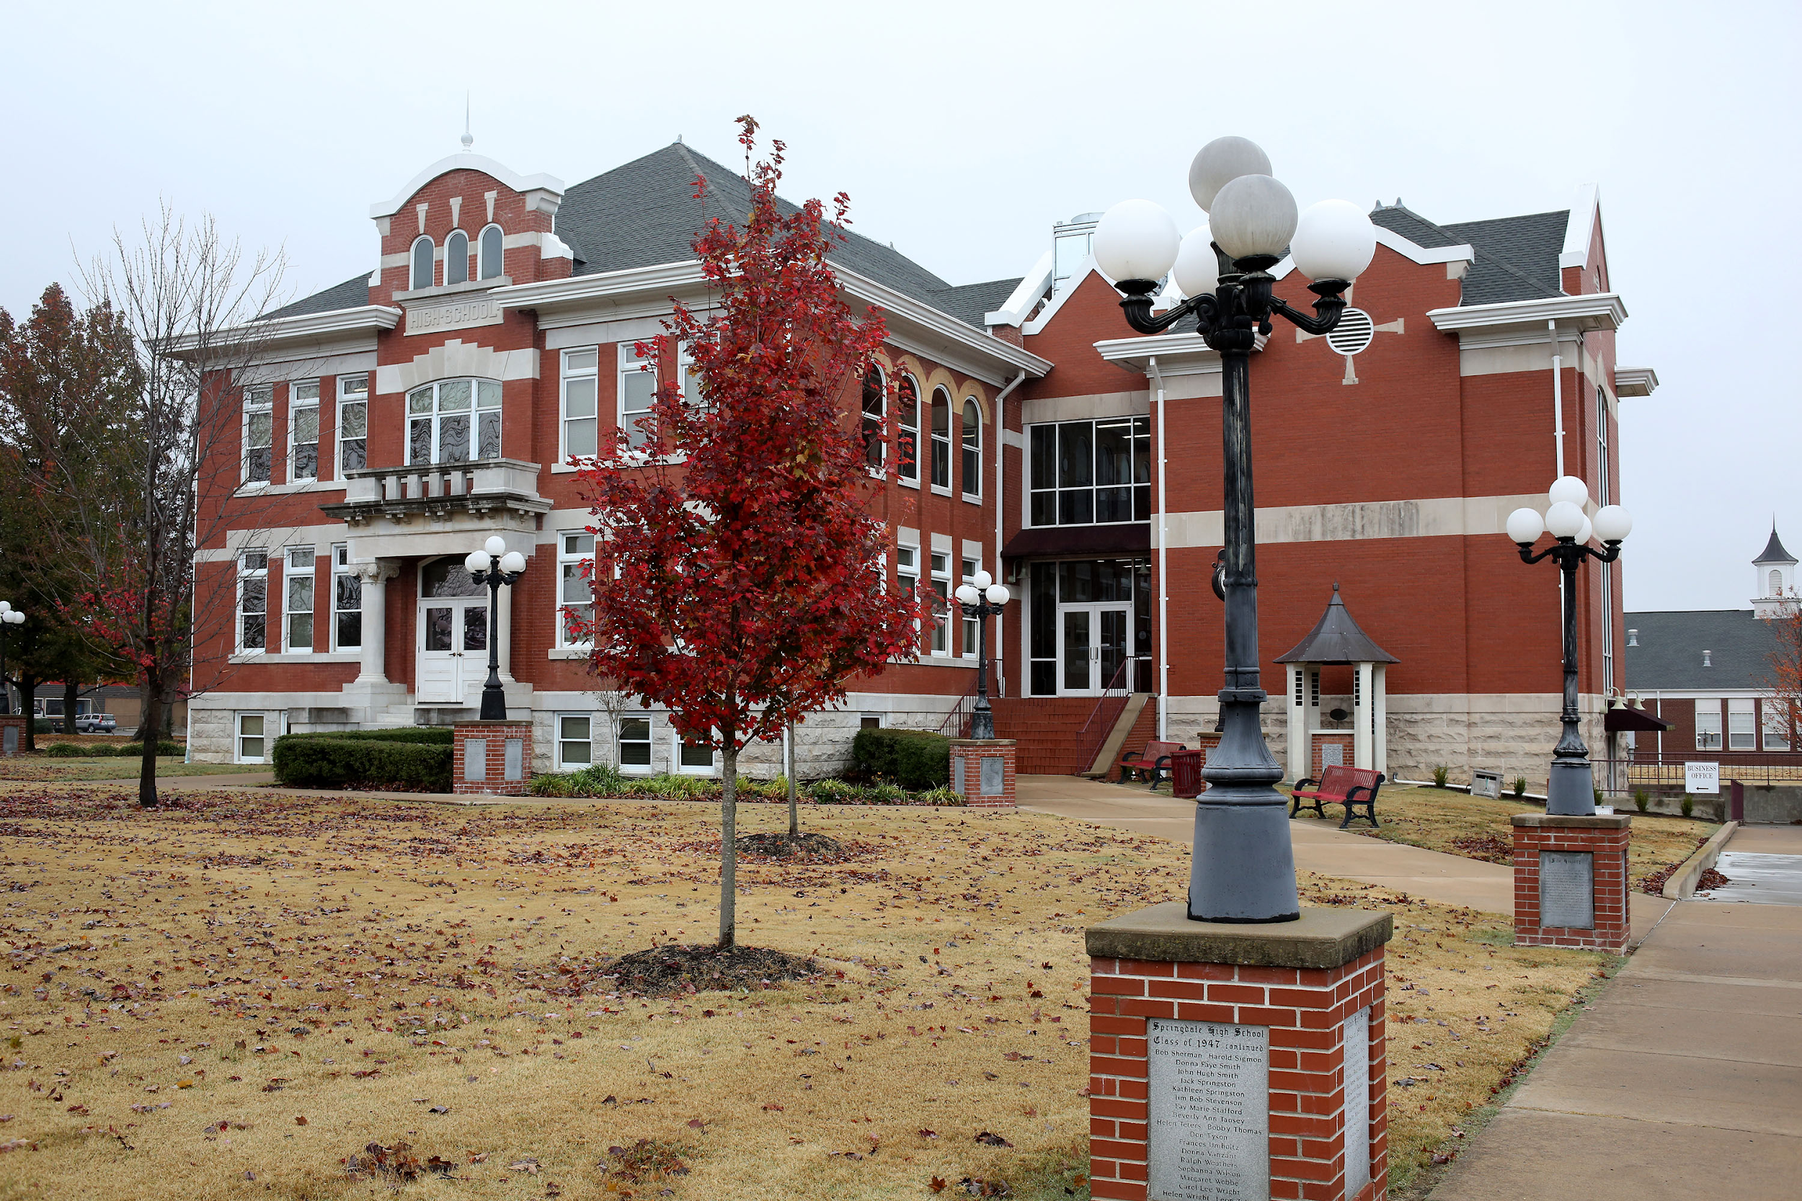
31 Schools
4
18
4
1
4

Slide 4

Start with “WHY”

Slide 5
The History of Springdale Schools
Doubling in size in 20 years to become the largest, most diverse district in Arkansas with 23,000 students and 53 spoken languages, Springdale School’s success can be attributed to all stakeholders having a voice in supporting students at the highest level.
Springdale School District meets the needs of all students through a collaborative stakeholder approach. The 400 migrant students are supported throughout the year in all grade levels across all schools.

Slide 6
Springdale Schools Migrant Program
Ethnicity
45.5% -Pacific Islander/Native Hawaiian
38.5% -Hispanic/Latino
6.5% - Asian
5.5%- White
4.0%- Black/African American
English Learner
95.8%- English Learners
4.2%- Non English Learners

Slide 7
Springdale Schools Migrant Program
Academic Growth
Literacy- 77% of the migrant students met or exceeded their goals in the MAP testing
Math- 81% of the migrant students met or exceeded their goals in the MAP testing this year
Credit Recovery- 100% of the secondary-aged migrant students that were behind credits participated and completed credit recovery programs sponsored by the school district

Slide 8

Springdale Schools Migrant Program Funding

Slide 9
Migrant Support
That support is realized through the work of dedicated tutors supporting the instruction of each Migrant student. In addition, the tutors build strong partnerships with family members addressing parenting skills and providing parents with instructional plans to support student learning at home.
Our 400 Migrant students are members of a 23,000 student body who are served in the district’s 31 schools, that offer traditional, transformational, and innovative instructional practices.

Slide 10
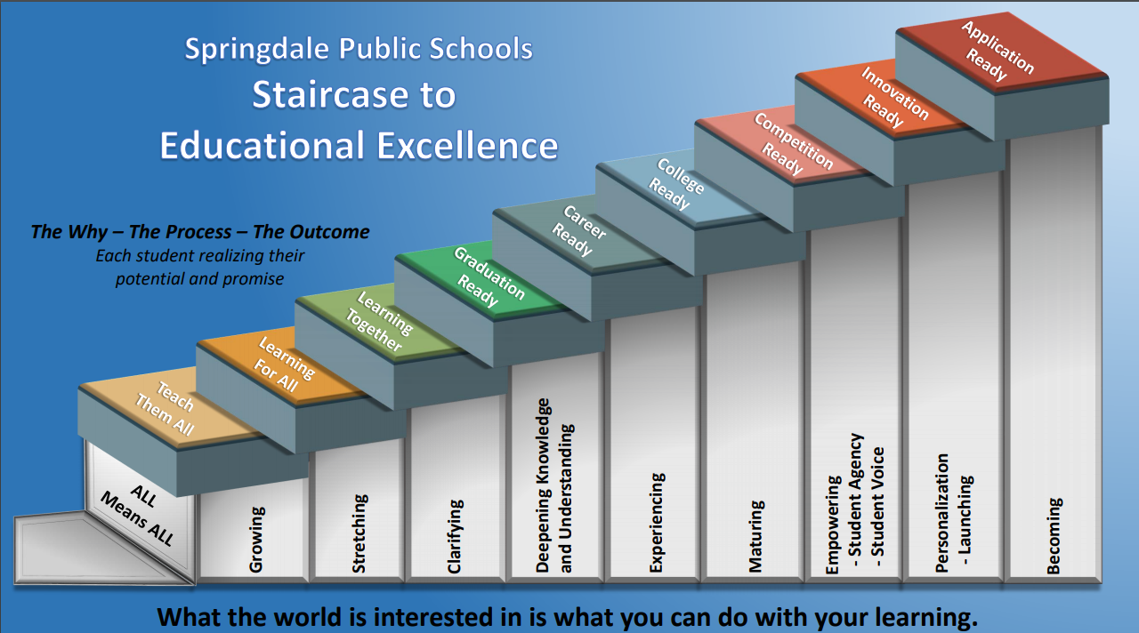
Migrant Support
These practices are highlighted by a personal education plan for each student includes sound traditional and emerging innovative practices. Students also benefit from the District’s mastery teaching program
and the district’s
one-to-one
technology
support system.

Slide 11
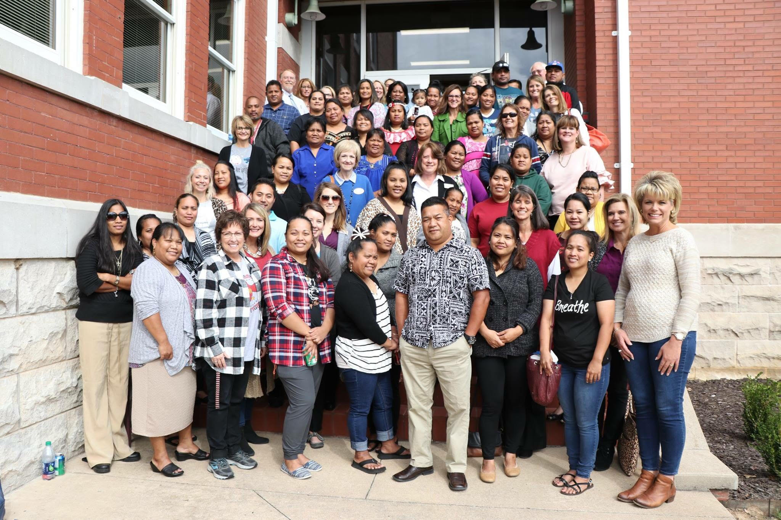
Parental Involvement
The district has the largest family literacy program in the nation. The program features an opportunity for parents to learn right alongside their children while building a knowledge of the English language and community resources that are available.

Slide 12
Migrant Program Recommendations to Achieve Increased Equity.
Additional Tutors to keep lower ratios to support and personalize student learning at a higher level.
Many of our students have food insecurities. A system to stay connected year around that offers healthy meals would benefit students overall wellbeing.
Supporting the students academically through year round tutoring and education opportunities. Students would benefit from having additional time to practice and work on deficient skills due to high mobility.
Helping parents with additional educational resources, materials, and supplies to assist the child’s learning in the home.

Slide 13
Recommendations Con’t
Develop methodologies to track student movement and academic progress. This would minimize a loss of instruction and help in identifying learning deficits as soon as possible.
Increase participation in Pre-K programs to enhance early childhood readiness for learning.
Increase participation in the extra-curricular activities of the school.
Provide additional intensive training in the use of instructional technologies that would facilitate learning and increase opportunities for higher learning.
Focus support for social and mental health needs of students and families.
Optimize access to local, state and federal funding to assure equity in participation in extracurricular or whole life activities of the school.
Notes:
To assure equity and participation in both curricular and extra curricular ways fo

Slide 14
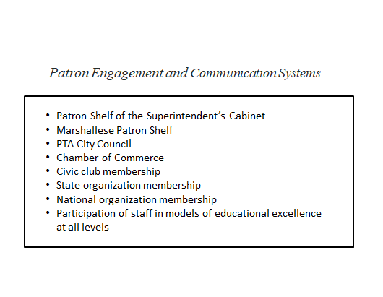
Patron Engagement and Communication Systems
ARKTESOL
National Center for Families Learning

Slide 15
A large district requires systems to be effectively developed and implemented.
Leadership
Leadership
relationships
Relationships
Community
Families
Curriculum
Families
Curriculum
Instruction
Instructions
Assessments
Assessments
Teachers
Teachers
Culture
Culture
Community

Slide 16
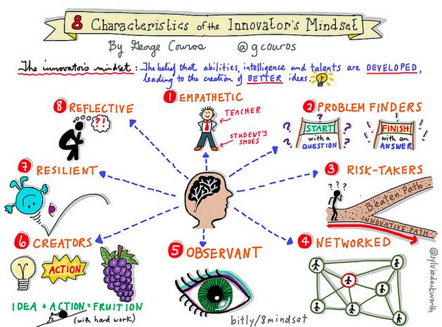

Slide 17
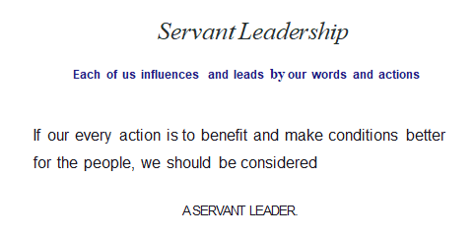

Slide 18
Thank you

